Slide 1
Robotics and IoT Club Secondary Years Level 2 - Week 3
Roohi Banu

Slide 2
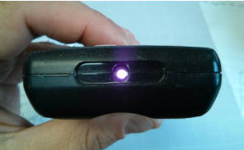
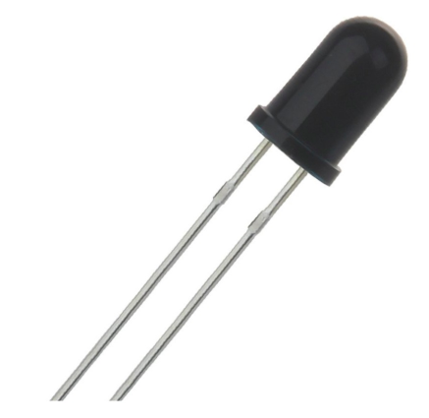
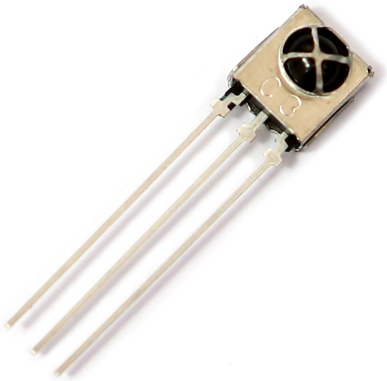
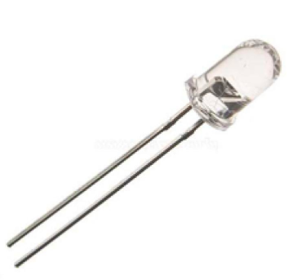
IR Sensors
IR Receivers (Rx)
IR Transmitter (Tx)

Slide 3
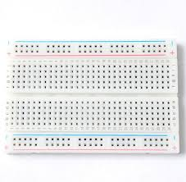
Working of IR Tx/Rx
IR Tx
IR Rx

Slide 4
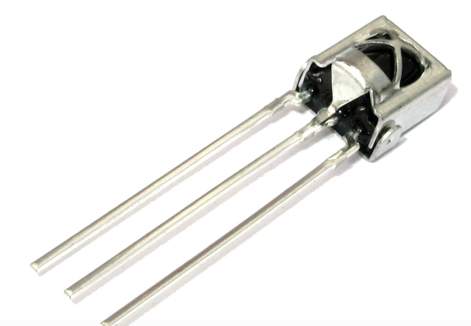
Three Pin Rx Circuit
SIGNAL
GND
3.3V

Slide 5
KeyPad

Slide 6
Code for KeyPad

Slide 7
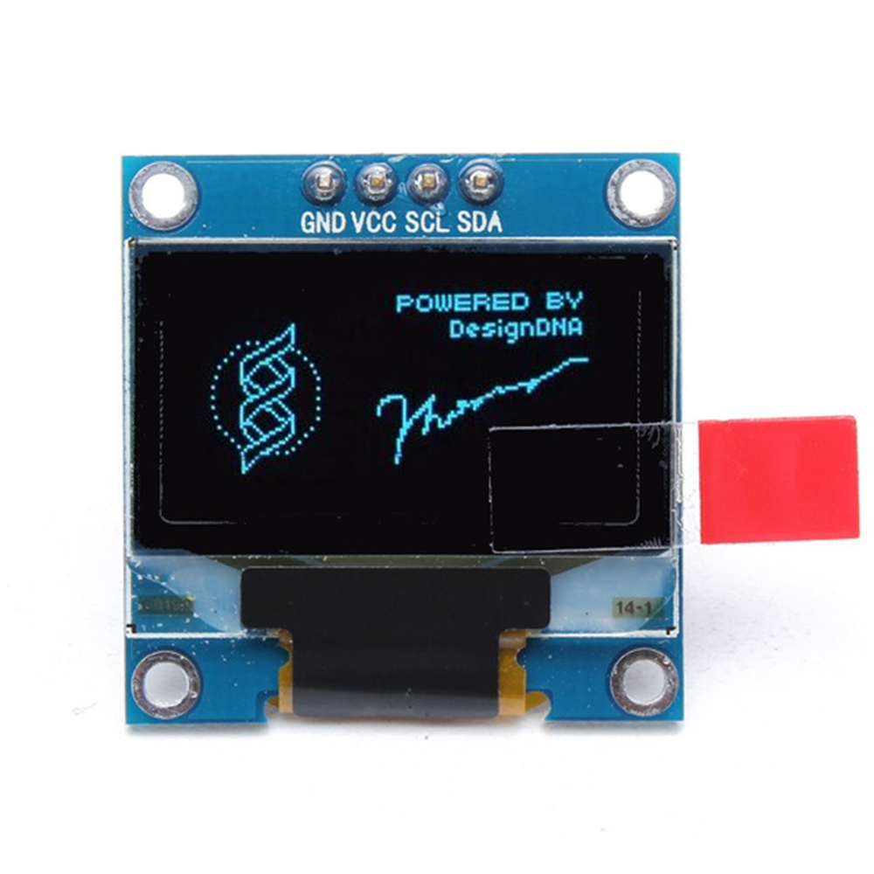
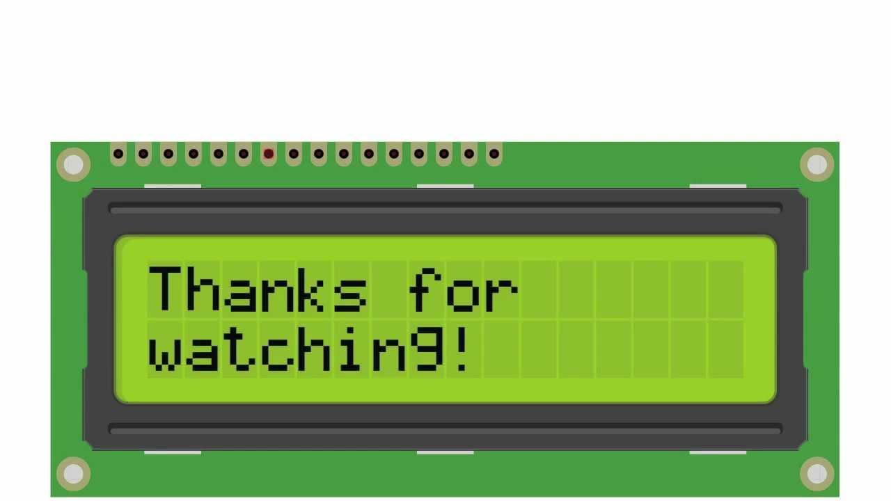
Display – OLED, LCD
OLED
LCD

Slide 8
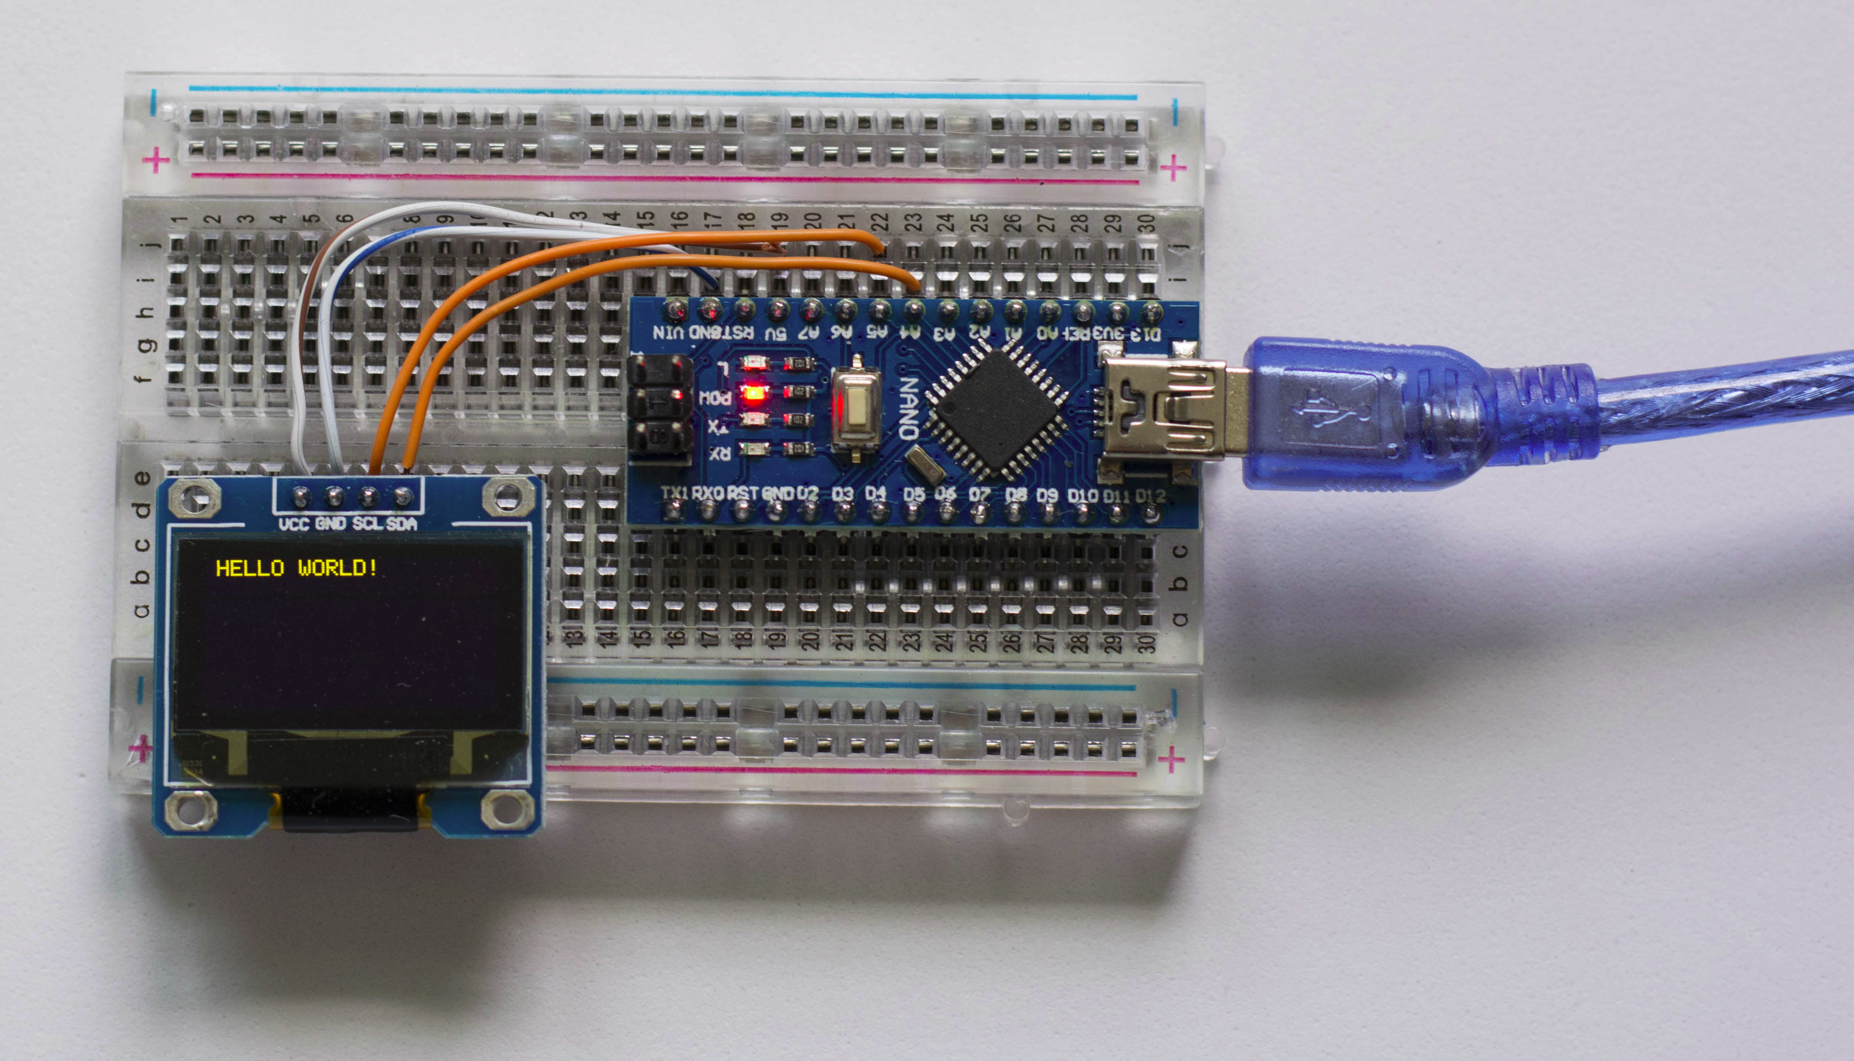
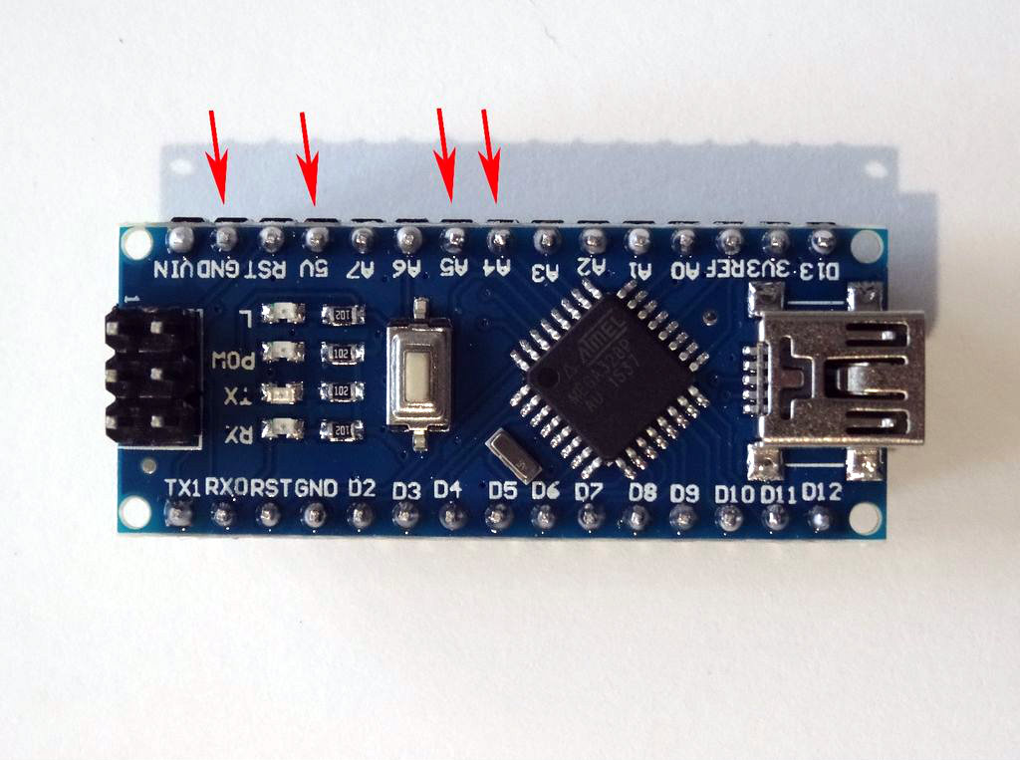
Connecting OLED to ARDUINO NANO
SCL
GND
5V
SDA

Slide 9
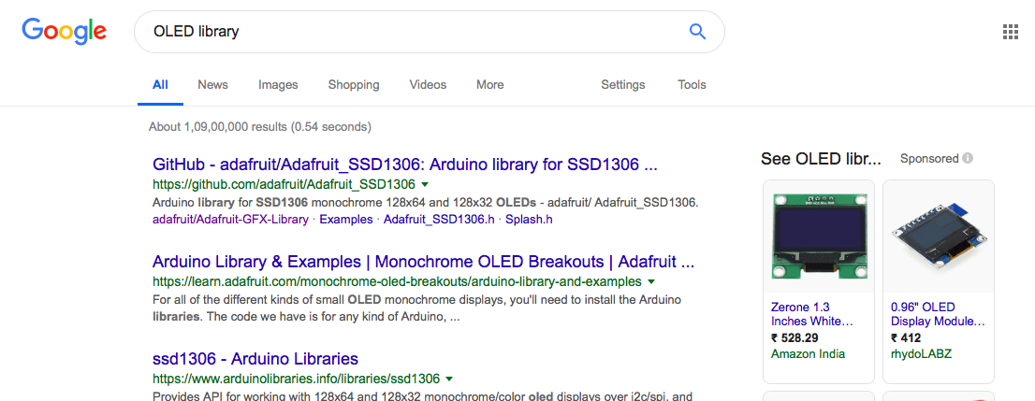

Adding OLED Library

Slide 10
Things to try at home - KeyPad -1
Case 1: Make the buzzer ‘beep’ when key ‘*’ is pressed
Case 2: when ‘*’ pressed => Buzzer beeps
‘7’ pressed => LED lit up
Case 3: Display the key pressed in OLED Display

Slide 11
Projects to try at home with IR…..
Control couple of LEDs using your TV/DVD Player remote
Control your Servo motor using remote control
How to control the Fans or Tube Lights using remote?
Can you think of controlling all the electrical appliances using remote in your room?

Slide 12
Communication with Arduino
Serial Monitor
InfraRed (IR)
Bluetooth
Cellular
WiFi
Ethernet etc….

Slide 13
Serial communication
Serial port is used for communication between Arduino and computer
Using serial port we can communicate with other devices

Slide 14
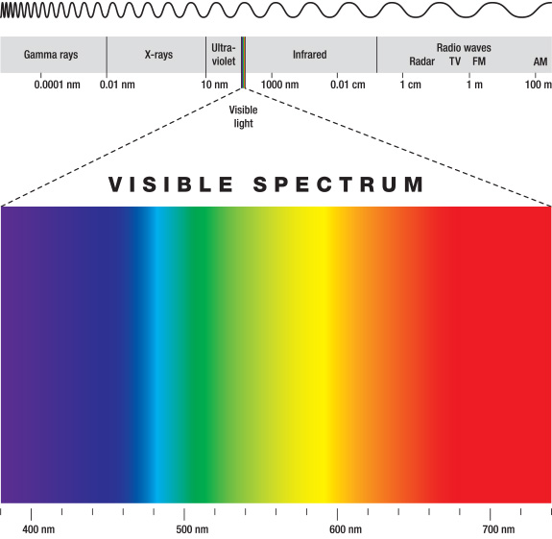
Bluetooth
www.bluetooth.com
Wireless communication between two devices
Transfers data through low power radio waves
It uses ISM radio frequency band for
communication (2.4 GHz to 2.485 GHz)
Uses very low power

Slide 15
Types of Bluetooth Devices
Class 1- Industrial use – Range of 100m
Class 2 – mobile phones, bluetooth headsets – 10m
Class 3 – 1m – rarely used

Slide 16
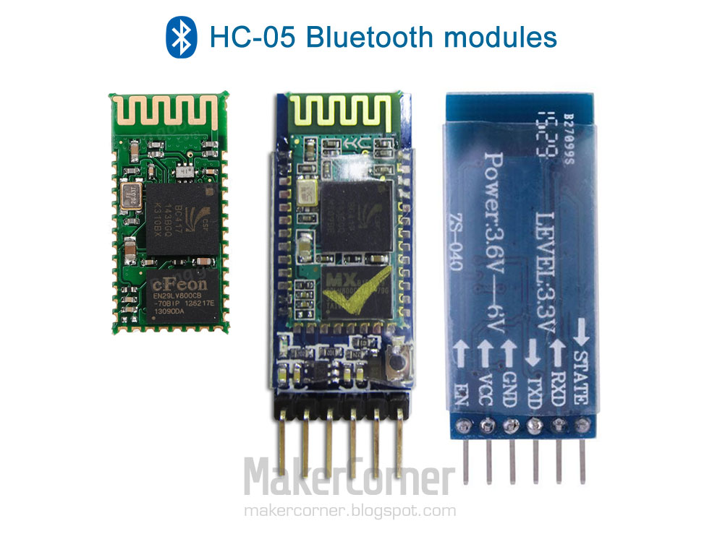
HC - 05
Class-2 wireless bluetooth transceiver module
Make the connections
with Arduino

Slide 17
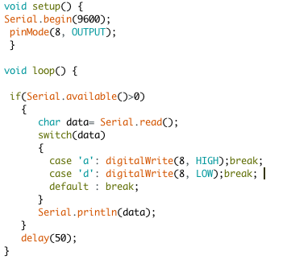
Code for Bluetooth

Slide 18

Arduino Bluetooth Control
Download App
Your Phone – Bluetooth ON
Check for HC05 in ’Available Devices’
Tap and Connect
Enter ’Password’ – 0000 OR 1234
Connect HC05 in the ‘APP’

Slide 19
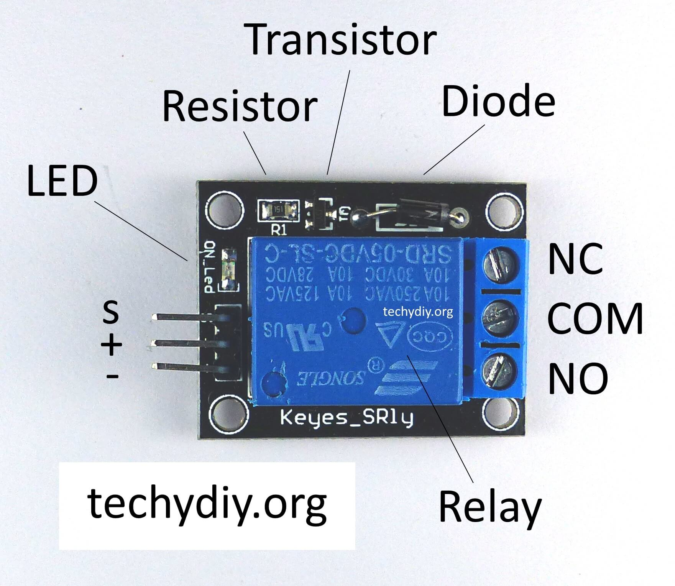
Relay
It is used to control high voltage electronic appliances
It is a switch which is electrically operated

Slide 20
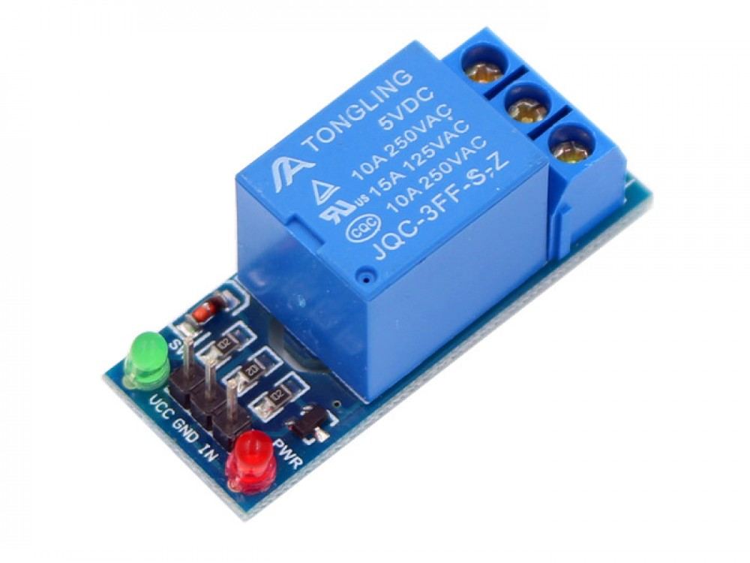
LED, Battery and Switch
2nd Circuit
High Voltage Circuit
Arduino
Low Voltage Circuit

